Slide 1
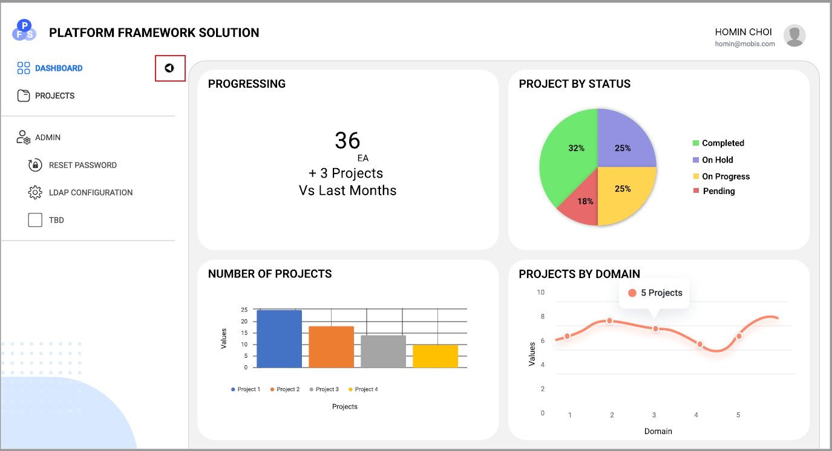
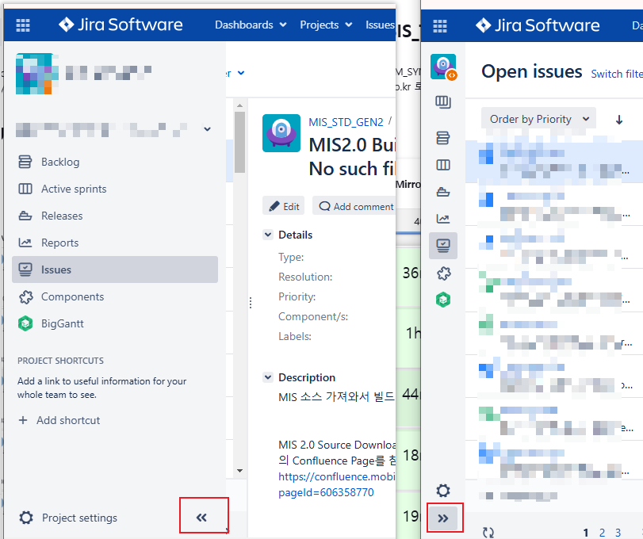
Common
Reference1
Please move the triangle icon on the left sidebar down like a Jira

Slide 2
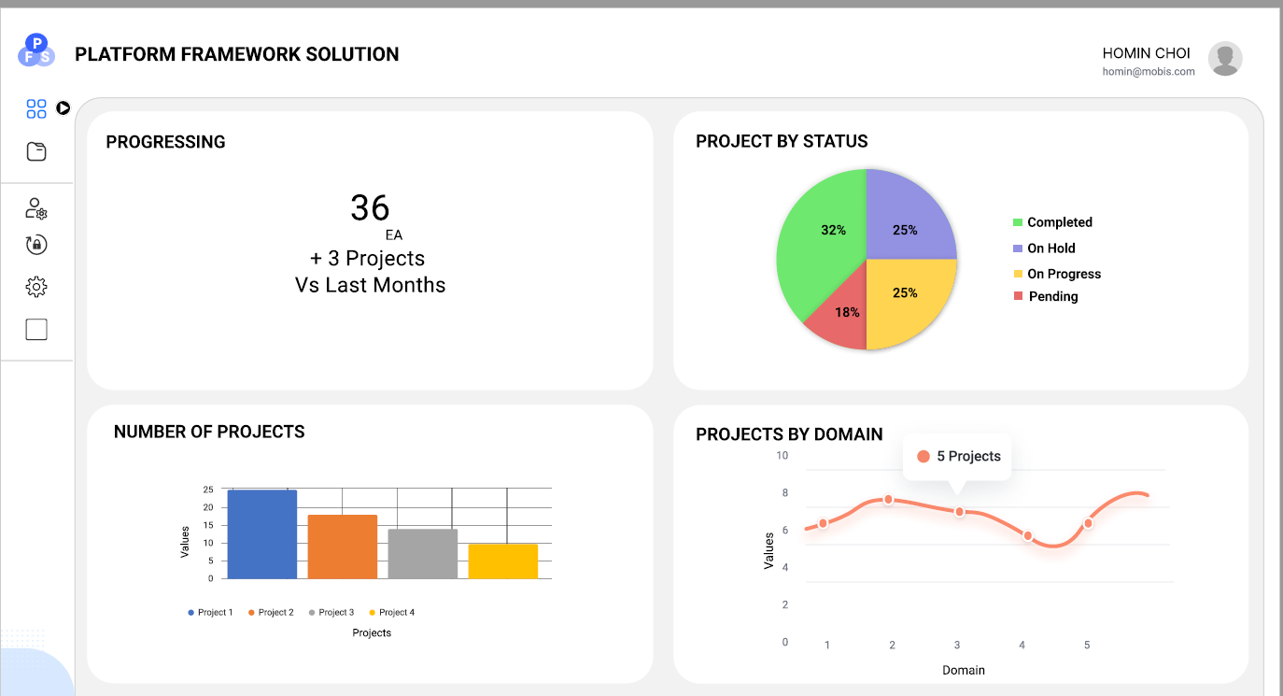
Overview / Quality Metric
1x1
1x1
1x1
1x1
1x2
We would like the charts on the overview dashboard and project detail screens to be displayed in various sizes and layouts.
1) The layout should be primarily structured in three columns, allowing for charts of sizes 1x1 and 1x2 to be arranged freely.

Slide 3
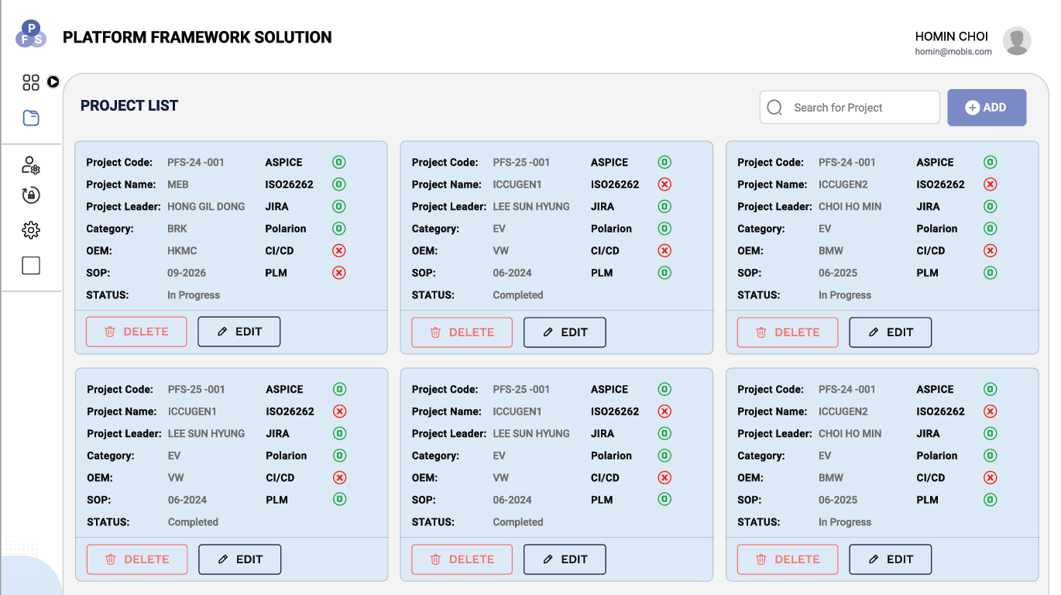
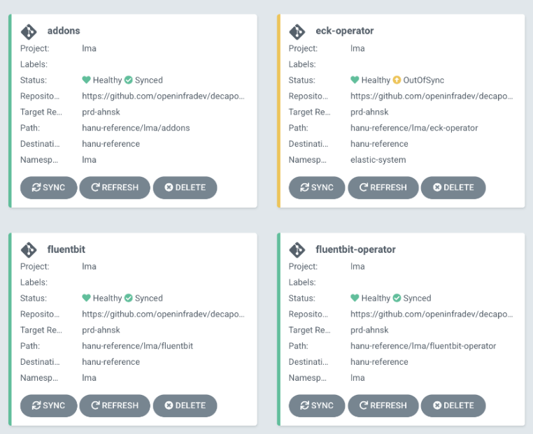
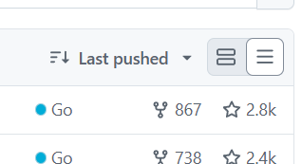
Project List (Card)
Details
ICCUGEN1V
Details
MEB
Reference1
Details
STEERING
Details
Brake
Please change the project cards to white without any color.
Display the Project Name separately, while keeping the rest of the information as it is.
It would be nice to represent the Status value on the left side with color, as shown in the Reference1. (In Progress: shades of green or blue, Completed: shades of gray).
Please add a button to toggle between card and list views, similar to Reference 2.
Reference2

Slide 4
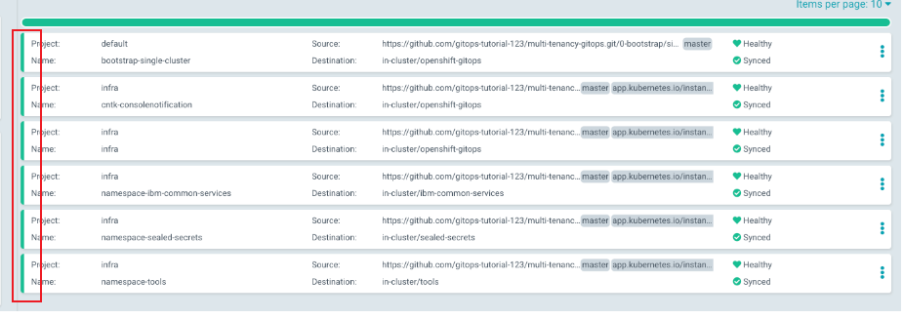
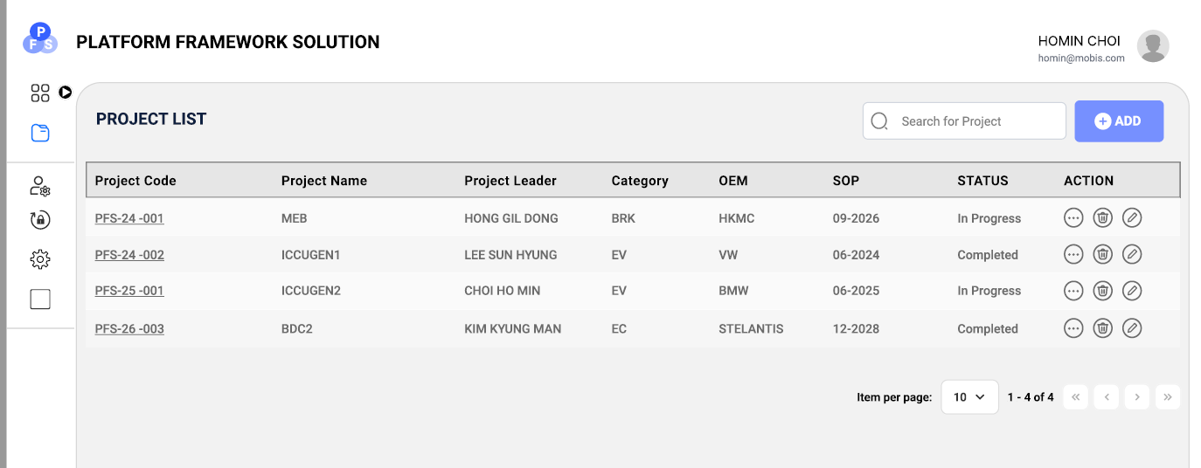
Project List (List)
Reference1
Please remove the border lines from the headers of the list table. It would be fine to have only the horizontal line between the header and the list.
Please display the status colors on the far left of the list format, as requested for the card format.
Please add the same button to toggle with card screen.

